Slide 1

Your personalized track to pelvic recovery.
Arba
Smart support for life after rectal surgery.
2025

Slide 2



Who stands behind iLARS?
Dovile Cerkauskaite, M.D. – Project idea and clinical concept; Symptom modules, educational content, and app texts; Coordination and collaboration with developer
Benedikt Bachmetjev, M.D. – Clinical co-design and technical lead; App development: design, coding, backend infrastructure
Audrius Dulskas, M.D., PhD – Clinical feedback and usability; Assessed interface from physician’s perspective; Contributed to logic and decision flow

Slide 3
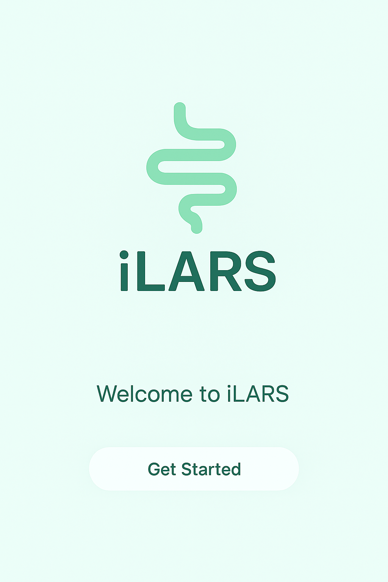
What is iLARS?
A Symptom Tracking App for Patients with Low Anterior Resection Syndrome

Slide 4

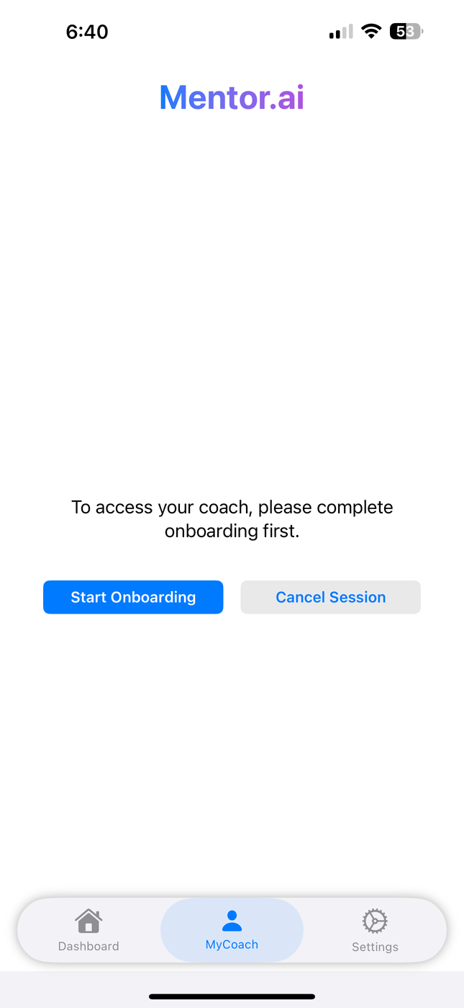
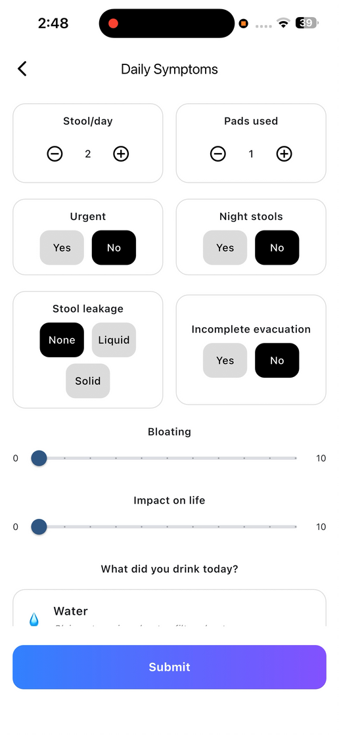
Current Gaps in Care
❌ No easy way for patients to track daily symptoms
❌ Important information often lost between visits
❌ Lack of structured, longitudinal data
❌ No digital tools tailored specifically to LARS

Slide 5
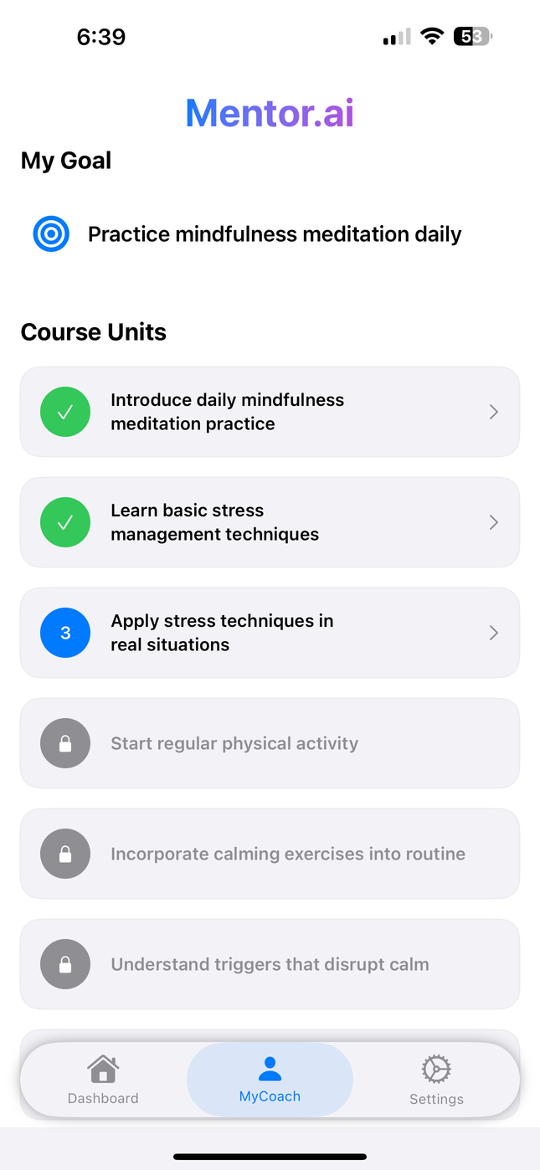
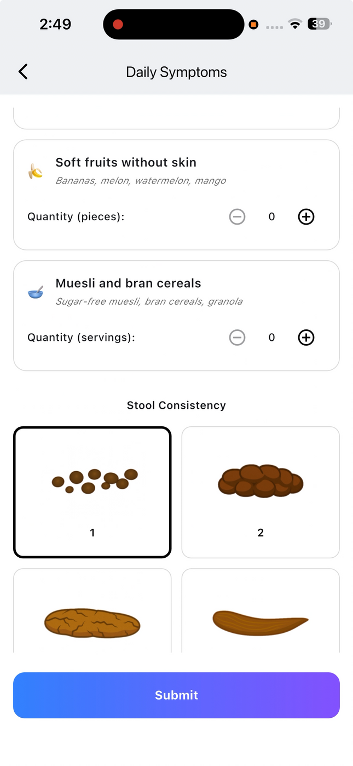
Introducing iLARS – App Designed For
✔ Daily symptom tracking
✔ LARS & CRADI-8 score calculators
✔ Stool diary (Bristol scale)
✔ Daily diet logging
✔ Pelvic floor & diet education
✔ Trend visualization & exportable PDF reports

Slide 6

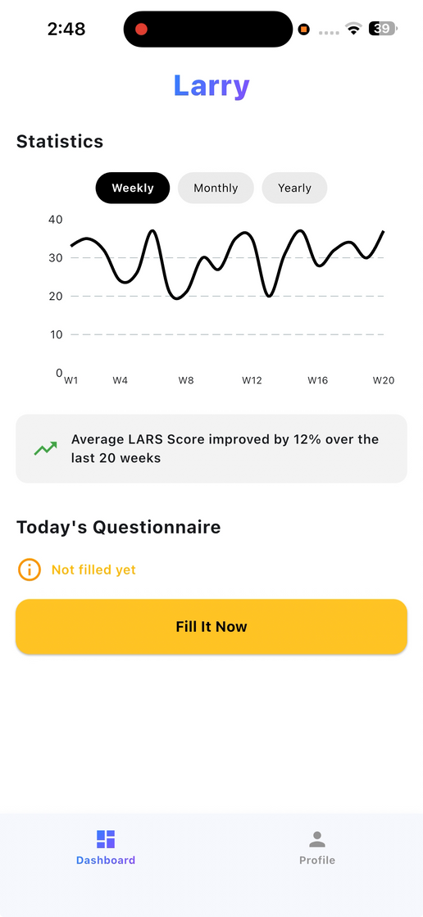
Patient Experience
Simple. Intuitive. Daily use in 1–2 minutes.
Easy onboarding – individualized codes
Track bowel habits and symptoms
Monitor progress via charts and scores
Share reports with your physician
Education for diet, exercises, and more

Slide 7
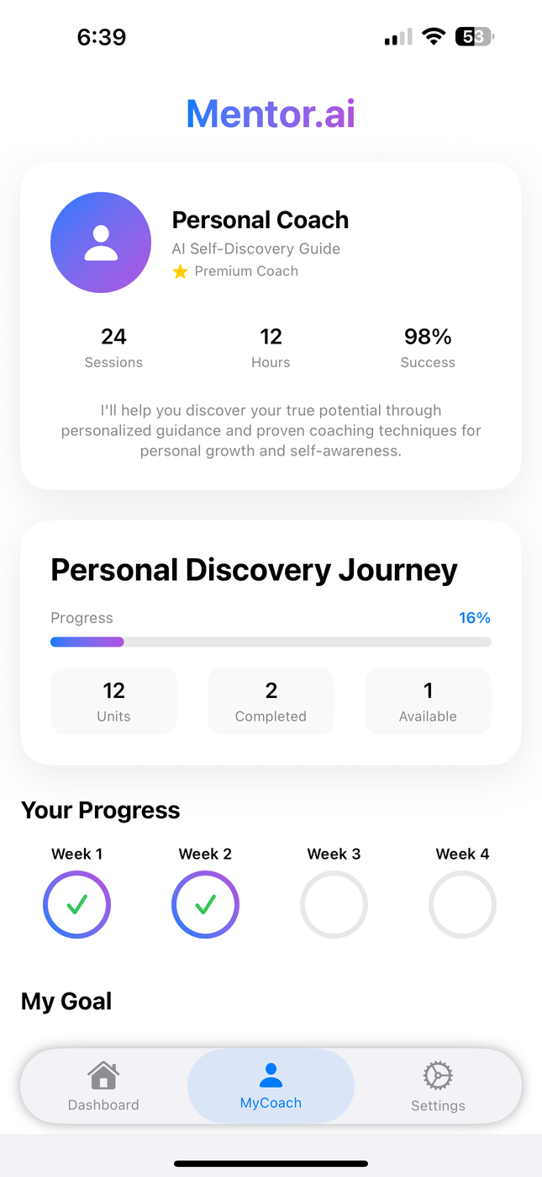
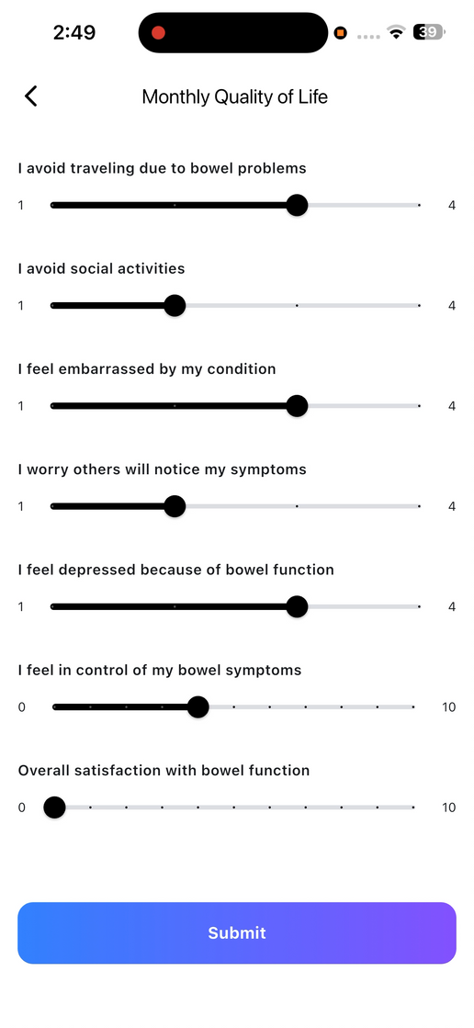
Benefits for Physicians
• See validated scores and symptom trends over time • Quickly identify worsening LARS or non-response • Discuss objective symptom data during follow-up • Save time and improve personalized care • Potential integration into EMRs or registries

Slide 8
What’s Next?
Pilot testing with patients
Integrating smart alerts & AI-driven suggestions
Multilingual interface
Seeking collaborators for testing and validation

Slide 9
Let’s bring structured, personalized, patient-driven care to LARS management

